Slide 1
Coffee Analysis
Presented by – Laxmikant S. Jadhav

Slide 2
Agenda
Agenda
Introduction
Customer Persona Analysis
Understand Nescafé’s and Starbucks’ Shopper Profiles
Customer Preferences
Identify Key Preferences and Behaviours
Comparative Analysis
Contrast Nescafé and Starbucks Customers
Strategic Recommendations
Propose Actions for Nescafé to Attract Starbucks Shoppers

Slide 3
INTRODUCTION
This presentation provides an in-depth analysis of Nescafe shoppers and their market behavior, alongside a comparison with Starbucks shoppers.
The objective is:
“ To analyze who Nescafe’s customers are, what is their preferences and habits look like, and how they differ from Starbucks shoppers. This will help Nescafe better understand their audience and identify opportunities to attract more customers.“
The dataset used for this analysis includes a variety of important features such as:
Demographics: Age, gender, and income groups
Population Characteristics: Shopper behavior patterns
Shopper Distribution: % of Nescafe Shoppers, % of Starbucks Shoppers
Index Values: Relative performance of each demographic in comparison to the average population

Slide 4
Who Are Nescafé Buyers?

Slide 5
Demographic & Socioeconomic Profile
Age & Life Stage:
Strongest presence among adults aged 35-44 (23.2%) and 25-34 (19.9%).
Under-indexed in the 65+ group, indicating a younger to mid-aged target audience.
Dominated by adult singles (18.6%) and adult couples (16.2%), highlighting a mature but independent lifestyle preference.
Marital & Family Size:
Married (47.8%) and never married (25.3%) form the core.
Low presence of widowers and separated individuals.
Large families, both younger and older, form a notable portion of the shopper base, indicating family-oriented value purchase behavior.
Education & Employment:
Well-represented across educational levels, with a tilt toward some college (21.3%) and high school/GED (22.5%).
Nearly half are employed full-time (49.1%), complemented by retired (12.0%) and part-time workers (10.1%).

Slide 6
Who Are Nescafé Buyers? – Income & Behavioral Insights
Income Distribution:
Low to mid-income groups ($20k–$60k): ~52%
And a surprising high-income segment ($125k+): 20.9%, indicating dual appeal—affordable everyday brand with premium flexibility.
Key Behavioral Indicators:
Consumer profile suggests:
Value-conscious but brand-loyal.
Looking for consistency and comfort rather than experimentation.
Driven by habitual consumption integrated into daily routines.
Nescafé appeals across the spectrum, with notable presence in:
Balanced reach across working professionals, retirees, homemakers, and students.

Slide 7
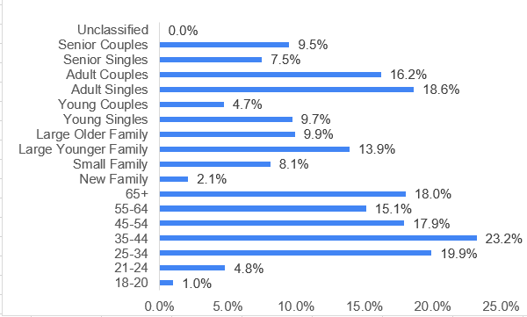
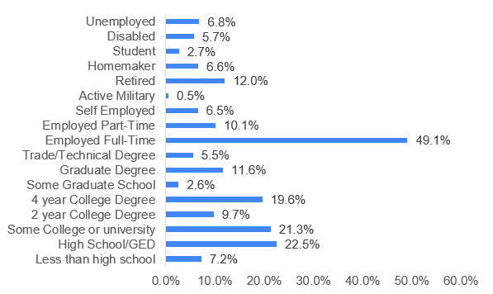
Customer Persona-Data
Age & Life Stage
Education & Employment

Slide 8
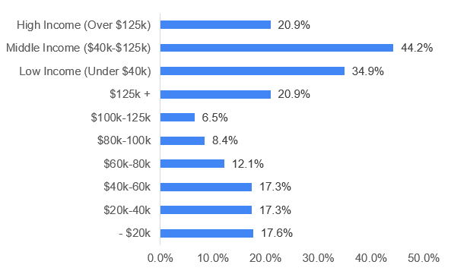
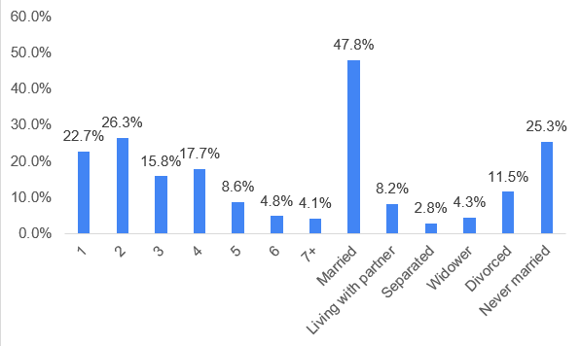
Customer Persona-Data
Income Distribution
Marital & Family Size

Slide 9

Summary Persona
A middle-aged or older adult (45+), often part of a couple or small household, with a more modest to moderate income ($40K–$100K). They're less likely to hold graduate degrees, and more are retired or not in full-time employment. These shoppers are generally from rural or suburban middle/working-class areas, with practical needs driving their purchases, often for the household rather than just themselves.

Slide 10
Who Are Starbucks Buyers?

Slide 11
Demographic & Socioeconomic Profile
Age & Life Stage
The largest age group is 65+ (24%), followed by 55–64 (19.7%), 35–44 (18.9%), and 45–54 (17.8%).
Life stage-wise, Adult Couples (19.5%), Adult Singles (15.8%), and Senior Couples (14.2%) dominate.
Marital & Family Size
Married individuals make up the majority at 54.2%.
Most shoppers belong to 2-person households (34.5%), followed by 1-person (22.9%) and 3-person (17%).
Majority do not fall under large family categories, indicating limited presence of families with young children.
Education & Employment
Education is strong: 25.5% have some graduate education, and 20.6% attended some college or university.
51.9% are employed full-time, and 18.7% are retired, showing a mix of working professionals and older consumers.

Slide 12
Income & Behavioral Insights
Income Distribution
A significant 33.5% earn $125K+, and income distribution is relatively even from $20K to $100K (each band around 11–13%).
This suggests higher-income professionals are a core customer base.
Key Behavioral Indicators
Lifestyle: The most common lifestyles are Suburban Middle Class (19.4%), Urban Middle Class (17.2%), and Rural Middle Class (12.7%) — showing appeal across locations.
Ethnicity: Predominantly White/Caucasian (65.4%), followed by Black/African American (10.2%).
Generation: Starbucks appeals broadly to Gen X (33.3%), Boomers+ (32.5%), and Millennials (27.4%), with limited Gen Z reach (6.7%).

Slide 13
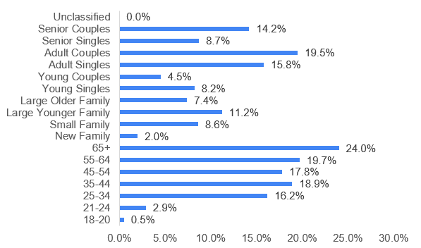
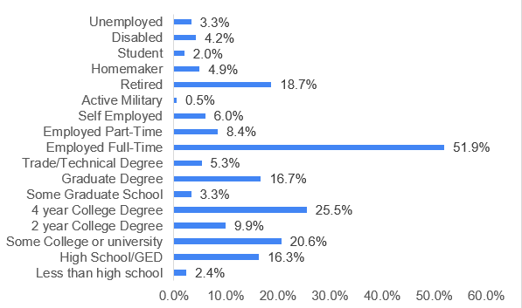
Customer Persona-Data
Age & Life Stage
Education & Employment

Slide 14
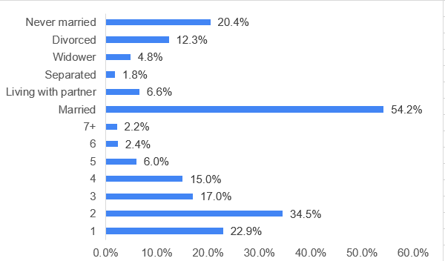
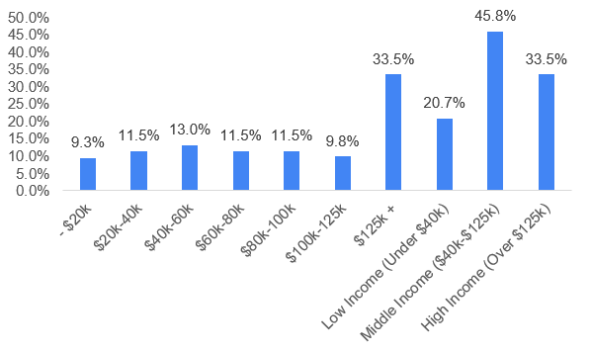
Customer Persona-Data
Income Distribution
Marital & Family Size

Slide 15
Summary Persona
A working adult or couple aged 35–64, educated (often with graduate studies), typically married, and earning a moderate-to-high income ($60K–$125K+). They live mostly in suburban or urban middle-class areas, buy for both individual and household needs, and are split between professionals and retirees.

Slide 16
What are the Nescafe shopper's preference ?
Diet-conscious:
4.8% vegan (Index 185)
12.6% lactose-free (Index 156)
3.2% grain-free (Index 213)
Wellness-forward:
23.3% very active (Index 115)
15.4% follow health trends (Index 127)
Media preference:
Print (Index 201), radio (207), outdoor ads (201)
Strong response to emails/texts (Index 328)
Brand engagement: 52.1% try new products (Index 257) 34.9% status-driven (Index 727), 37.9% values-driven (Index 354)
Advertising attitudes:
16.4% find ads entertaining (Index 129)
6.6% trust advertised brands (Index 161)

Slide 17
What are the Nescafe shopper's preference ?
31.8% enjoy online shopping (Index 128)
56.5% think online deals are worse (Index 1087)
40.3% prefer well-known brands (Index 433)
Hobbies & lifestyle:
Painting/drawing (Index 105), writing/blogging (114)
Engage in fishing (40.8%, Index 309), marathons (8.3%, Index 692), tennis (18.2%, Index 700)
Financial mindset:
17.1% are spenders (Index 118), 2.8% delay savings (Index 215)
Digital skepticism:
Only 4.4% engage via web (Index 26)
38% prefer physical stores (Index 197)
Shopping behavior:

Slide 18
What are the Starbucks shopper's preference ?
Health-aware
3.0% vegan (Index 116), 8.3% lactose-free (Index 103)
30.5% exercise regularly (Index 105), 13.2% follow health trends (Index 109)
Digitally engaged
Mobile (56.7%), web (57.1%), social (41.8%) top touchpoints
19.3% influenced by mobile ads (Index 98)
Shopper profile
26% enjoy online shopping (Index 104)
Balanced mindset: 29.4% value quality (Index 104), 37.3% price-conscious (Index 95)
Ad attitudes
13.4% entertained by ads (Index 106)
4.4% trust ads (Index 106)

Slide 19
What are the Starbucks shopper's preference ?
Lifestyle & hobbies
Baking (33.5%), cooking (38.7%), music (45.1%)
Group fitness: Yoga (11.3%, Index 111), dancing (16%), biking (12.6%, Index 109)
Private label view
45.4% say PL quality has improved (Index 101)
26.7% would switch if PL is on sale
Balanced shopping habits
58.6% are list makers, 36.8% use coupons (Index 105)
Financial outlook
15.6% spenders (Index 107), 1.6% delay savings (Index 117)
35% regularly save (Index 100)

Slide 20
Difference between Nescafe and Starbucks based on Shopper Characteristics
By age group
Nescafé skews towards younger population with 1% aged 18–20 and 19.9% aged 25–34, vs. Starbucks' 0.5% and 16.2%. Starbucks leads among older shoppers—19.7% aged 55–64 vs. Nescafé’s 15.1%.
By Education Level
Nescafe shoppers generally have lower education levels than Starbucks shoppers For example, 7.2% of Nescafe shoppers have less than a high school education, while only 2.4% of Starbucks shoppers fall into this category
By Employment
A higher percentage of Nescafe shoppers are employed full-time compared to Starbucks shoppers Starbucks shoppers have a higher rate of retirement 18.7% compared to Nescafe shoppers 12.0%
By Income
More Nescafé shoppers earn under $20K (17.6% vs. 9.3%), while Starbucks dominates the $125K+ bracket (33.5% vs. 20.9%). Both are similar in the $20K–$60K range.

Slide 21
Nescafé vs Starbucks Shoppers
Nescafé Shoppers …
… tend to rely more on traditional methods like television, print media, and radio
… have solitary hobbies & niche fitness
… are traditional, brand-loyal, value-driven, offline-focused
Starbucks shoppers …
… tend to rely on online platforms, especially mobile devices and social media, to learn about products
… have creative hobbies, prefer group activities and are social
… are digital-first, pragmatic, price-aware, lifestyle-driven

Slide 22
How Nescafe can attract/capture Starbucks shoppers?
Launch digital-first campaigns & e-commerce bundles
Promote premium, wellness-aligned SKUs (e.g., plant-based)
Introduce creative collabs (baking kits, music-themed packs)
Test omnichannel media—blend outdoor with social & mobile
Offer flexible pricing, small indulgences, digital coupons
Emphasize ethical sourcing + premium quality narrative

Slide 23
THANK YOU!

